Slide 1
Modeling and control of Voltage Source Converters (VSCs) Part II
SUNRISE Summer School
Belgrade 8-11/7/2025
Manuel Barragán Villarejo
Department of Electrical Engineering
University of Sevilla
(manuelbarragan@us.es)

Slide 2
Outline
Introduction
Three-phase inverter
Pulse Width Modulation (PWM)
Coupling filter
Averaged model of Three-Phase Three-wire Two-level VSC in abc
Averaged model of Three-Phase Three-wire Two-level VSC in dq
Grid synchronization: Phase Lock Loop (PLL)
VSC control
Current control in dq coordinates
Computation of reference current
DC-link voltage control

Slide 3
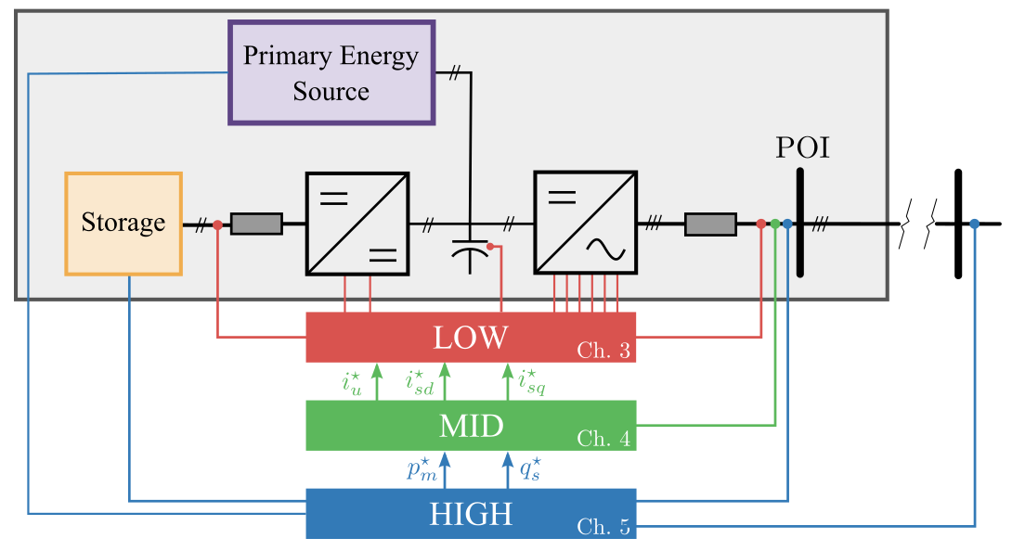
VSC control
Hierarchical controller of the VSCs
LOW LEVEL CONTROL
PWM and current controller
MID LEVEL CONTROL
P-Q Control: GFL or GFM
DC bus voltage control
HIGH LEVEL CONTROL
Primary frequency control
Voltage control
Power Smoothing
EMS of ESS
Notes:
In this scenario, VSCs, the main interface between renewable generation and the electrical system, have a very important role thanks to their control capacity. They can provide a series of ancillary services, which, together with energy storage systems, can address many challenges.
In this way, it is necessary to propose a control scheme that allows providing the different auxiliary services in the time range that corresponds to them, from services with very fast dynamics: electromagnetic flames to those whose dynamics are slower and classically characteristic of power systems.

Slide 4
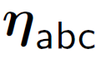
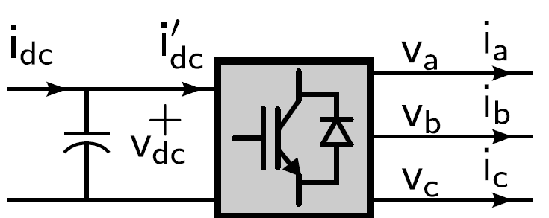









VSC control
Variables to be controlled:
DC voltage: $v_{dc}$
Currents: $i_{abc}$
Inputs: $η_{abc}$
Subactuated control system: 3 inputs to control 4 outputs
Take advantage of the different dynamics of the control scheme
Low level: Current controller:
Fast dynamics
Usual time constant: 1-10 ms
Mid level: DC voltage controller:
Slow dynamics
Usual time constant: 10-100 ms
$$i_{d}$$
Current regulator
$$i_{q}$$
$$η_{d}$$
$$i_{d}^{∗}$$
$$η_{q}$$
$$i_{q}^{∗}$$
+
+
$$v_{dc}$$
DC voltage regulator
$$v_{dc}^{∗}$$

Slide 5
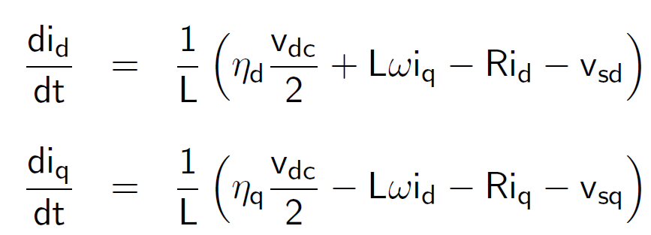
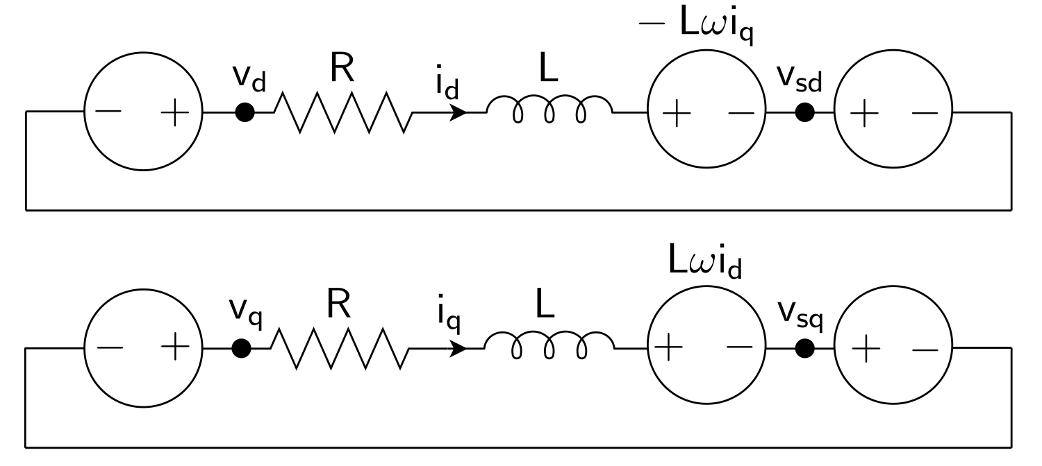
Current control in dq coordinates
AC-side equivalent model in dq:

Slide 6
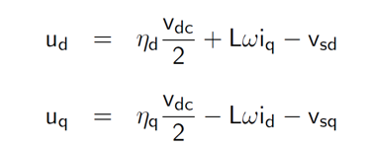
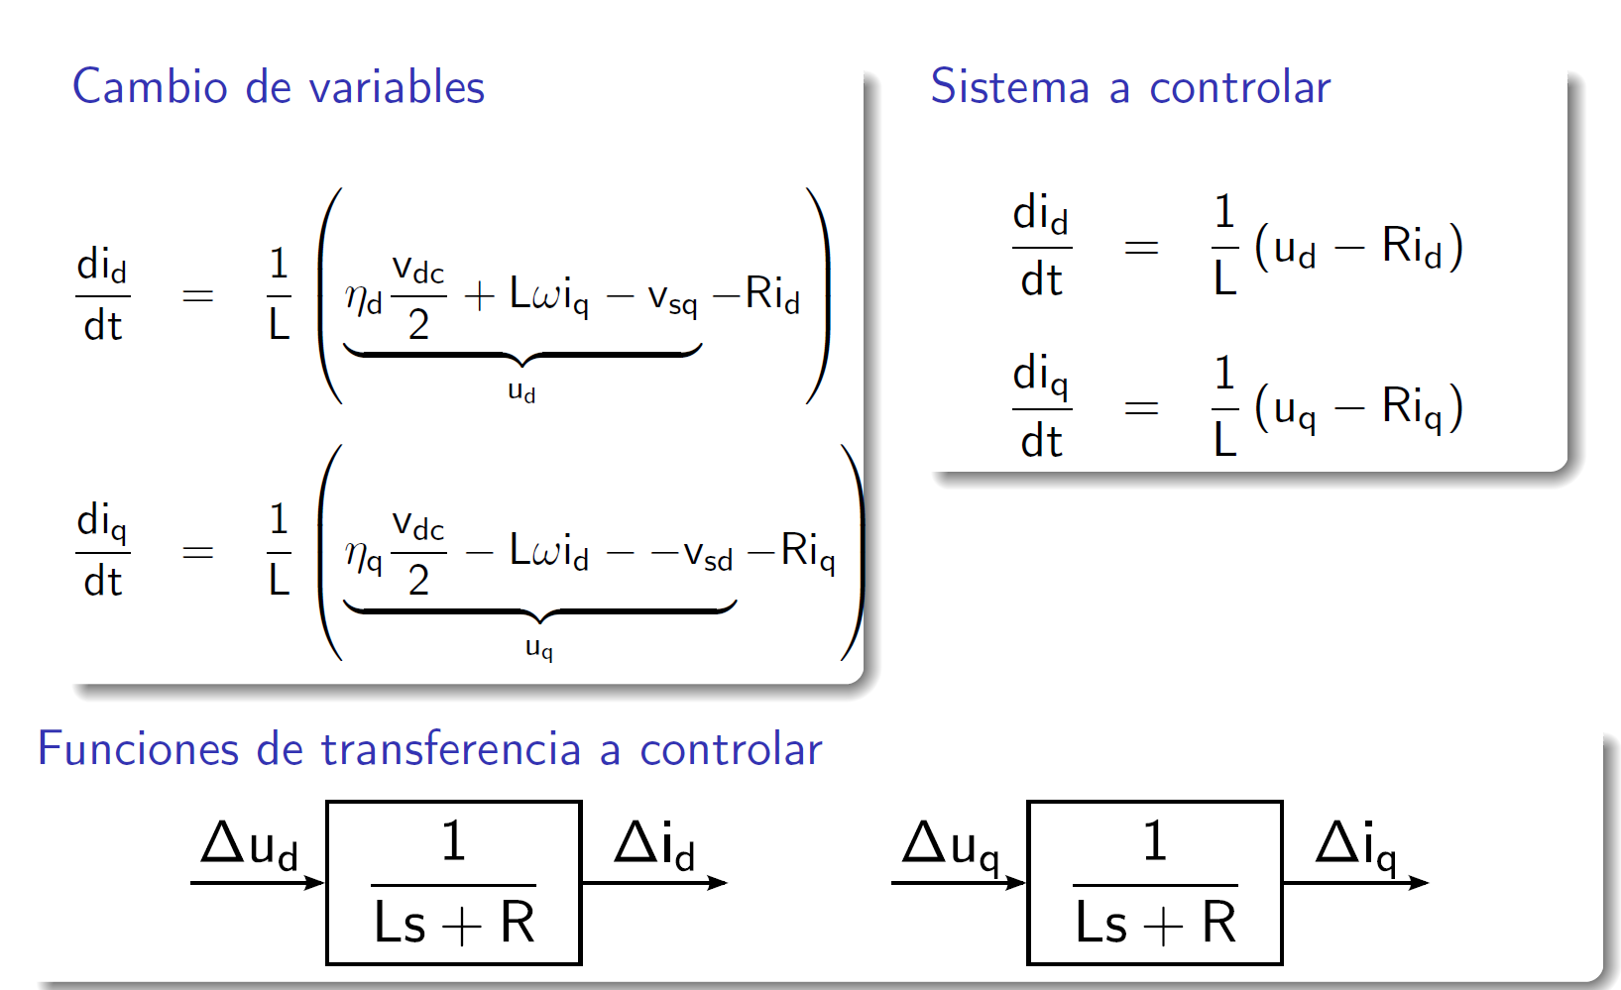
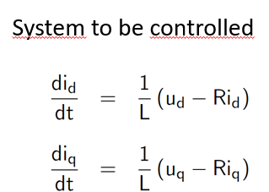
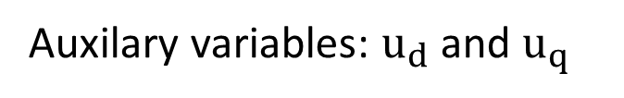
Current control in dq coordinates
Auxilary variables: $u_{d}$ and $u_{q}$

Slide 7
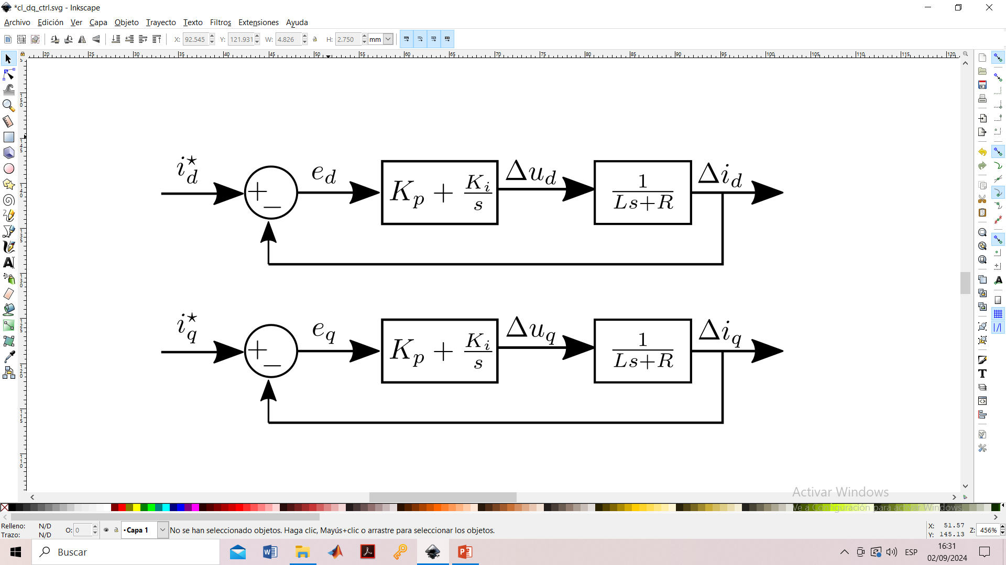
Current control in dq coordinates
Transfer function to be controlled
PI current controller

Slide 8
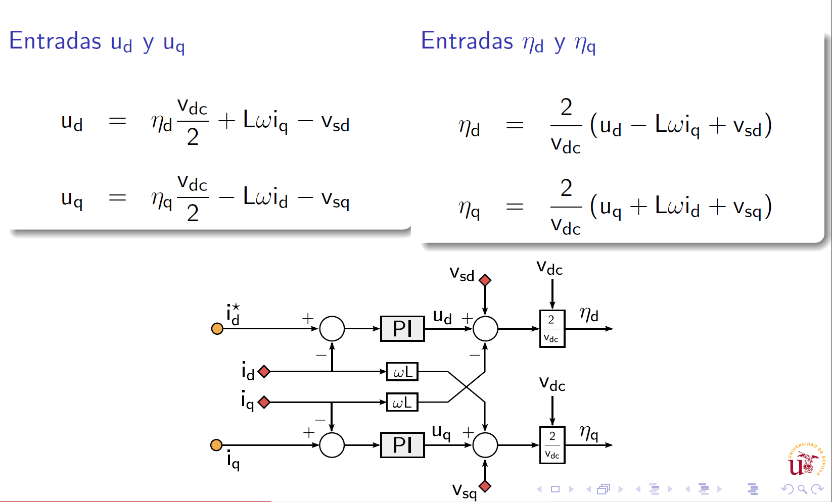
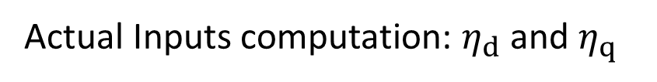
Current control in dq coordinates
Relationship auxiliary and actual inputs
Actual Inputs computation: $η_{d}$ and $η_{q}$

Slide 9
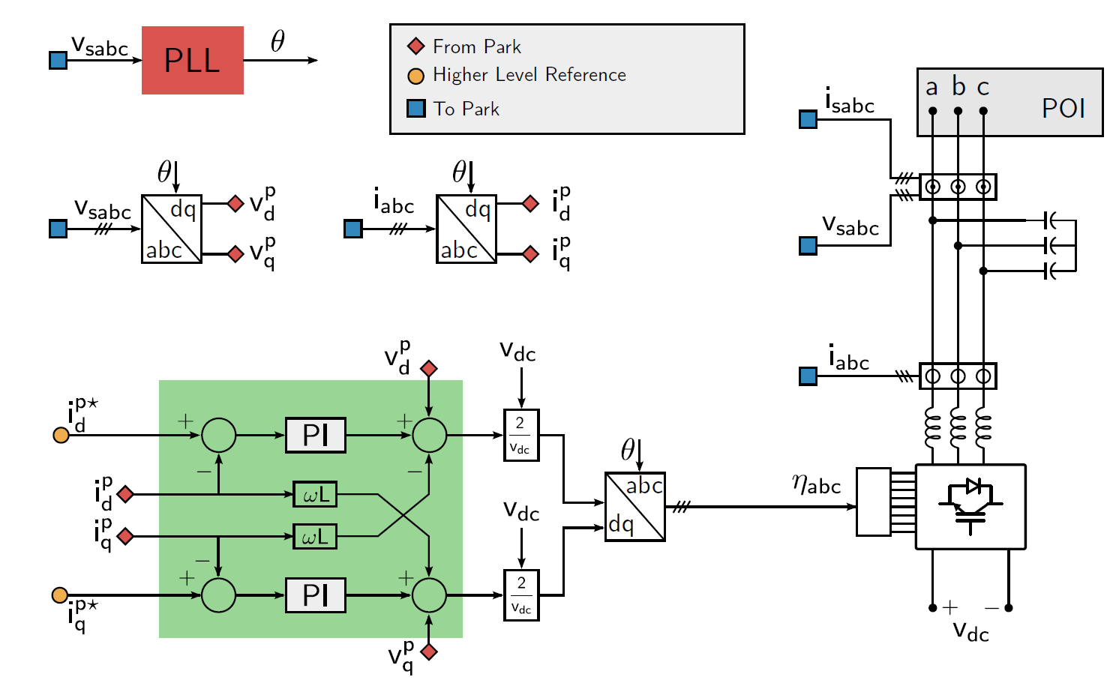
Current control in dq coordinates

Slide 10
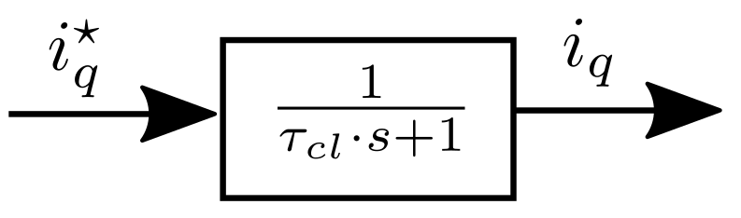
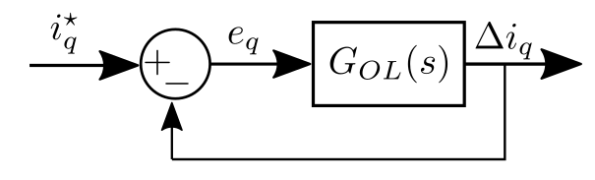
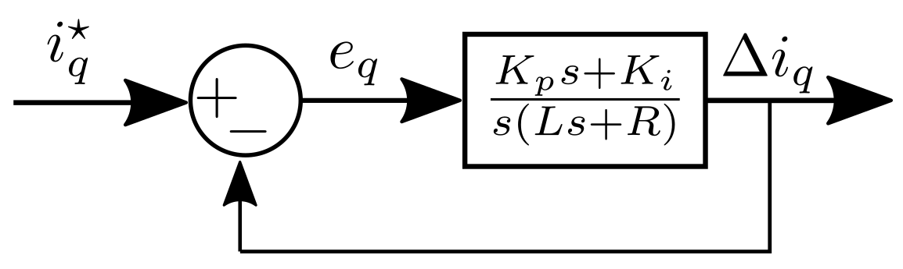
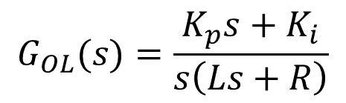
Current control in dq coordinates
Tuning of the controller gains
Desired 1st order
closed-loop dynamics
Block Algebra
Open Loop
Transfer function
$$G_{OL}(s)=\frac{K_{p}s+K_{i}}{s\left(Ls+R\right)}$$

Slide 11
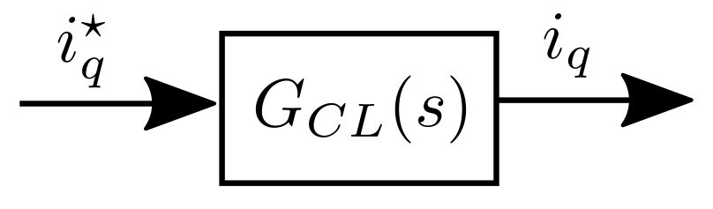

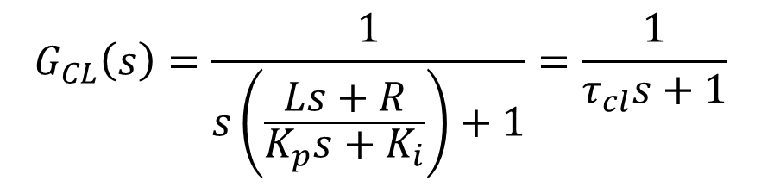
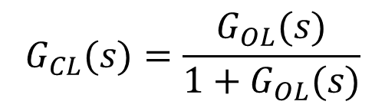
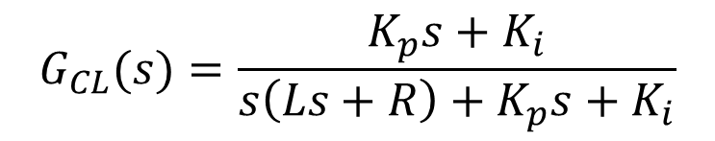
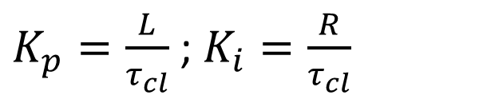
Current control in dq coordinates
Tuning of the controller gains
Block Algebra
Closed Loop
Transfer function
$$G_{CL}(s)=\frac{G_{OL}(s)}{{1+G}_{OL}(s)}$$
$$G_{CL}(s)=\frac{K_{p}s+K_{i}}{{s\left(Ls+R\right)+K}_{p}s+K_{i}}$$
Identifying $G_{CL}\left(s\right)$ with the desired closed-loop dynamic
$$G_{CL}\left(s\right)=\frac{1}{s\left(\frac{Ls+R}{K_{p}s+K_{i}}\right)+1}=\frac{1}{τ_{cl}s+1}$$
$$Ls+R=τ_{cl}\left(K_{p}s+K_{i}\right)$$
$K_{p}=\frac{L}{τ_{cl}}$ ; $K_{i}=\frac{R}{τ_{cl}}$

Slide 12
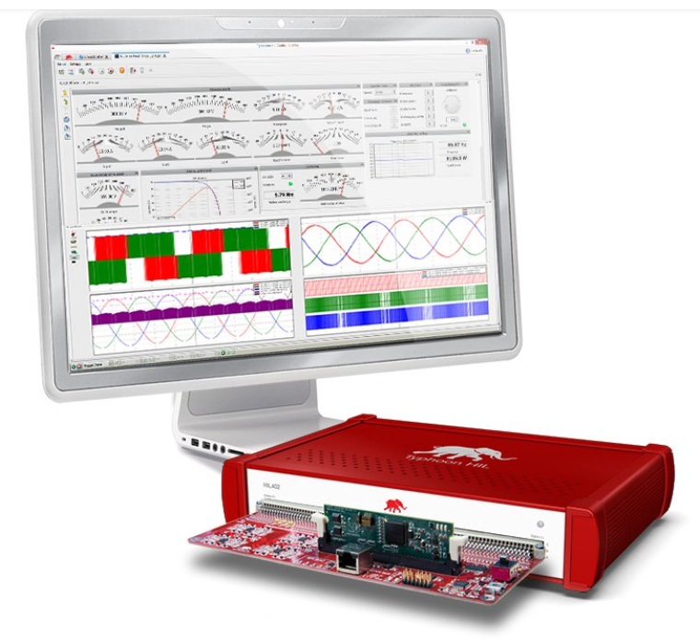
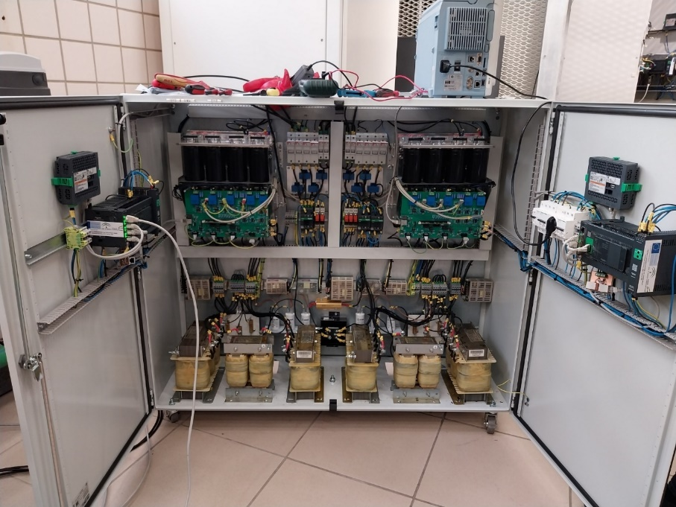
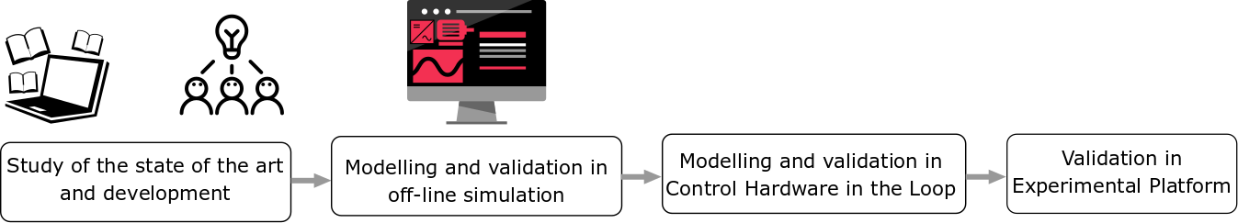
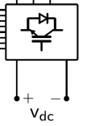
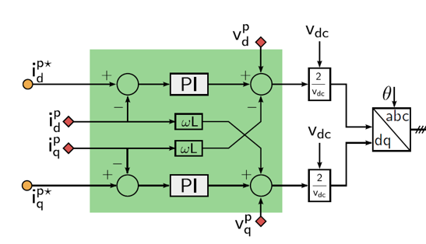

Methodology
✓
Plant
Control
SCADA
Notes:
In this scenario, VSCs, the main interface between renewable generation and the electrical system, have a very important role thanks to their control capacity. They can provide a series of ancillary services, which, together with energy storage systems, can address many challenges.
In this way, it is necessary to propose a control scheme that allows providing the different auxiliary services in the time range that corresponds to them, from services with very fast dynamics: electromagnetic flames to those whose dynamics are slower and classically characteristic of power systems.

Slide 13
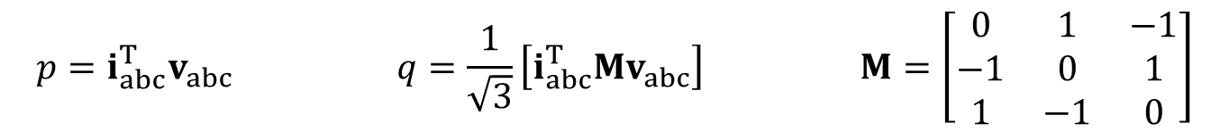
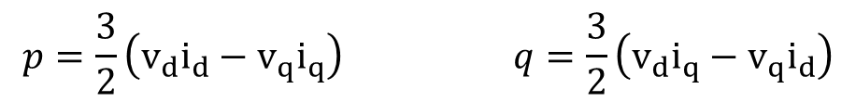
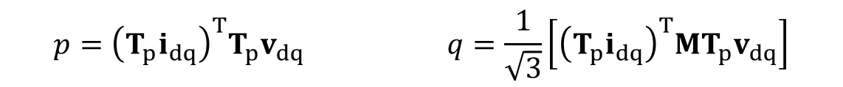
Computation of reference currents
Active and reactive power in abc coordinates:
Matrix formulation in abc coordinates:
Active and reactive power in dq coordinates:
$$p=i_{a}v_{a}+i_{b}v_{b}+i_{c}v_{c} q=\frac{1}{\sqrt{3}}\left[\left(v_{b}−v_{c}\right)i_{a}+\left(v_{c}−v_{a}\right)i_{b}+\left(v_{a}−v_{b}\right)i_{c}\right]$$
$$p={i_{abc}^{T}v}_{abc} q=\frac{1}{\sqrt{3}}\left[{i_{abc}^{T}Mv}_{abc}\right] M=\left[\begin{matrix}0 & 1 & −1 \\ −1 & 0 & 1 \\ 1 & −1 & 0\end{matrix}\right]$$
$$p={{\left(T_{p}i_{dq}\right)}^{T}T_{p}v}_{dq} q=\frac{1}{\sqrt{3}}\left[{{\left(T_{p}i_{dq}\right)}^{T}MT_{p}v}_{dq}\right]$$
$$p=\frac{3}{2}\left(v_{d}i_{d}−v_{q}i_{q}\right) q=\frac{3}{2}\left(v_{d}i_{q}−v_{q}i_{d}\right)$$

Slide 14
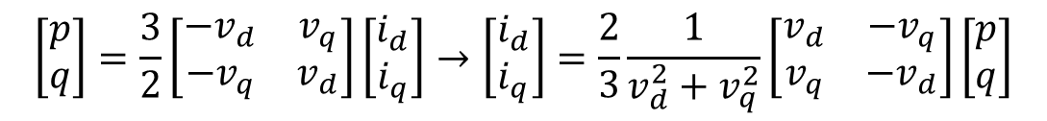
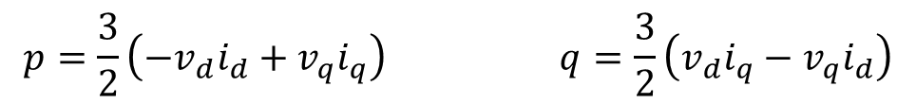
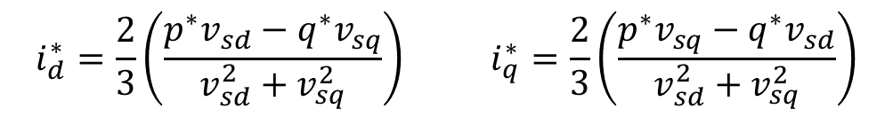
Computation of reference currents
Active and reactive power in dq coordinates (matrix form):
Current references in dq coordinates:
$$p=\frac{3}{2}\left(−v_{d}i_{d}+v_{q}i_{q}\right) q=\frac{3}{2}\left(v_{d}i_{q}−v_{q}i_{d}\right)$$
$$\left[\begin{matrix}p \\ q\end{matrix}\right]=\frac{3}{2}\left[\begin{matrix}−v_{d} & v_{q} \\ {−v}_{q} & v_{d}\end{matrix}\right]\left[\begin{matrix}i_{d} \\ i_{q}\end{matrix}\right]→\left[\begin{matrix}i_{d} \\ i_{q}\end{matrix}\right]=\frac{2}{3}\frac{1}{v_{d}^{2}+v_{q}^{2}}\left[\begin{matrix}v_{d} & {−v}_{q} \\ v_{q} & {−v}_{d}\end{matrix}\right]\left[\begin{matrix}p \\ q\end{matrix}\right]$$
$$i_{d}^{∗}=\frac{2}{3}\left(\frac{p^{∗}v_{sd}−q^{∗}v_{sq}}{v_{sd}^{2}+v_{sq}^{2}}\right) i_{q}^{∗}=\frac{2}{3}\left(\frac{p^{∗}v_{sq}−q^{∗}v_{sd}}{v_{sd}^{2}+v_{sq}^{2}}\right)$$

Slide 15

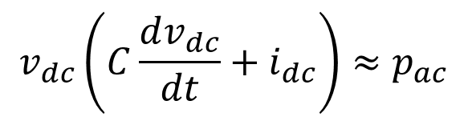




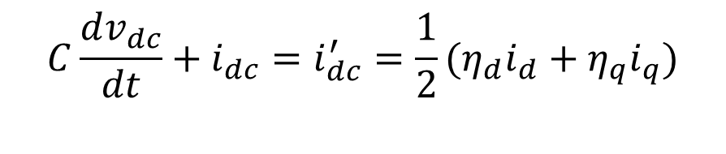
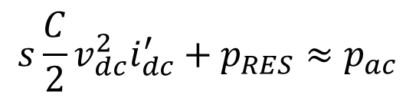
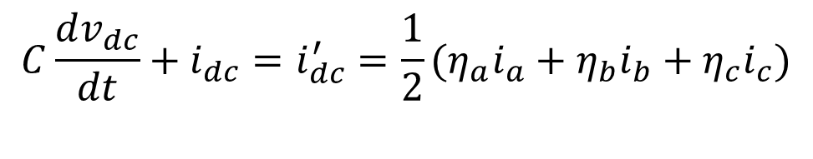
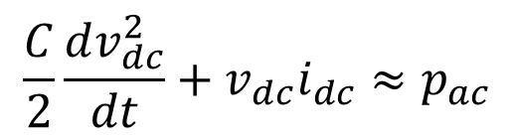
DC-link voltage control
$$p_{RES}$$
$$p_{dc}^{′}$$
$$p_{ac}$$
DC-side equivalent circuit in abc and dq:
Power balance between AC and DC side of the VSC
$$C\frac{dv_{dc}}{dt}+i_{dc}=i_{dc}^{′}=\frac{1}{2}(η_{a}i_{a}+η_{b}i_{b}+η_{c}i_{c})$$
$$C\frac{dv_{dc}}{dt}+i_{dc}=i_{dc}^{′}=\frac{1}{2}(η_{d}i_{d}+η_{q}i_{q})$$
$$v_{dc}\left(C\frac{dv_{dc}}{dt}+i_{dc}\right)≈p_{ac}$$
$$p_{dc}^{′}≈p_{ac}$$
$${v_{dc}i}_{dc}^{′}≈p_{ac}$$
$$\frac{C}{2}\frac{dv_{dc}^{2}}{dt}+{v_{dc}i}_{dc}≈p_{ac}$$
$${s\frac{C}{2}v_{dc}^{2}i}_{dc}^{′}+p_{RES}≈p_{ac}$$

Slide 16
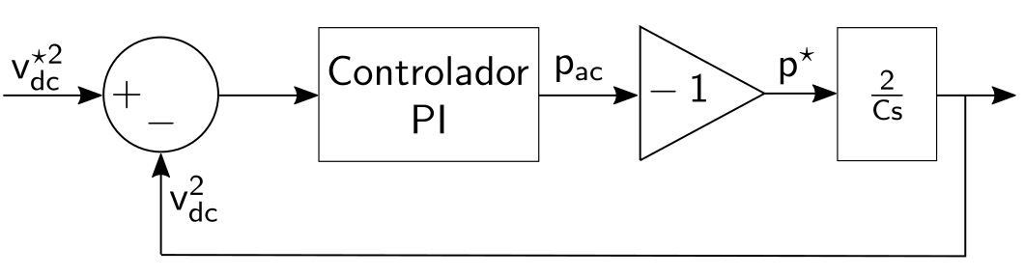



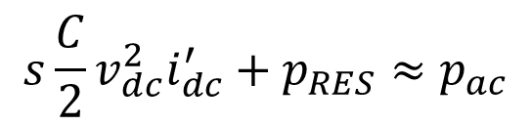
DC-link voltage control
PI regulator provides the active power reference to maintain $v_{dc}^{2}$:
$${s\frac{C}{2}v_{dc}^{2}i}_{dc}^{′}+p_{RES}≈p_{ac}$$
Perturbation
$$i_{d}^{∗}$$
PI
Current controller
PI
regulator
dq current
reference computation
$$η_{abc}$$
Plant

Slide 17
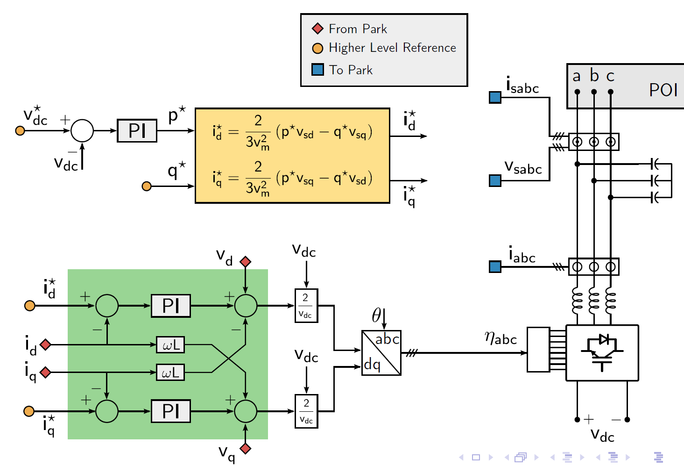
Computation of reference currents
DC-link voltage and current control

Slide 18

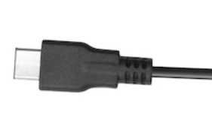

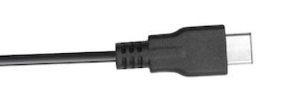
Methodology
✓
✓
Real Time Simulation
Real-Time Simulator
Host
PC
SCADA
Plant
Control
Notes:
In this scenario, VSCs, the main interface between renewable generation and the electrical system, have a very important role thanks to their control capacity. They can provide a series of ancillary services, which, together with energy storage systems, can address many challenges.
In this way, it is necessary to propose a control scheme that allows providing the different auxiliary services in the time range that corresponds to them, from services with very fast dynamics: electromagnetic flames to those whose dynamics are slower and classically characteristic of power systems.

Slide 19
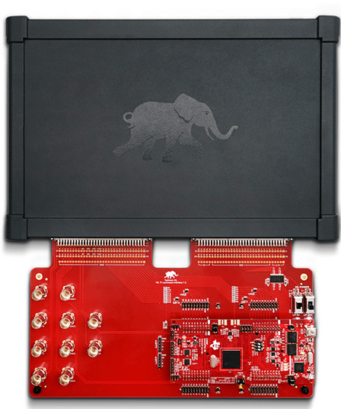
Methodology
✓
✓
C-HIL
Real-Time Simulator
Host
PC
Plant
DSP
SCADA
Control
Notes:
In this scenario, VSCs, the main interface between renewable generation and the electrical system, have a very important role thanks to their control capacity. They can provide a series of ancillary services, which, together with energy storage systems, can address many challenges.
In this way, it is necessary to propose a control scheme that allows providing the different auxiliary services in the time range that corresponds to them, from services with very fast dynamics: electromagnetic flames to those whose dynamics are slower and classically characteristic of power systems.

Slide 20
Outline
Introduction
Three-phase inverter
Pulse Width Modulation (PWM)
Coupling filter
Averaged model of Three-Phase Three-wire Two-level VSC in abc
Averaged model of Three-Phase Three-wire Two-level VSC in dq
Grid synchronization: Phase Lock Loop (PLL)
VSC control
Current control in dq coordinates
Computation of reference current
DC-link voltage control

Slide 21
Modeling and control of Voltage Source Converters (VSCs) Part II
SUNRISE Summer School
Belgrade 10-13/9/2024
Manuel Barragán Villarejo
Department of Electrical Engineering
University of Sevilla
(manuelbarragan@us.es)

